Slide 1
Cmpe 493 Information Retrieval Term Project Final Presentation
Mansur YeşİLBursa
Abdullah Yıldız
Can Devecİ

Slide 2
Overview
What we had done , Mansur Yeşilbursa
Improvements, Can Deveci
Evaluations,
Thoughts on Future Work, Abdullah Yıldız

Slide 3
Baseline System
Exact Match
On Training Set
Performance: 22% correct normalization on dev set
On Ontology
Improved performance by 11%
Performance: 33% correct normalization on dev set
Lemmatization
Improved performance by 4%
Performance: 37% correct normalization in dev set
Abbreviation Resolution
No improvement on performance
Performance: 37% correct normalization in dev set

Slide 4
Baseline System
Cosine Similarity
If exact match is not possible
Improves performance by 10%
Performance: 47% correct normalization on dev set

Slide 5
Evaluations
Algorithms | Model Improvement | Total Performance
Exact Match on Training Set | - | 22%
Exact Match on Ontology | 11% | 33%
Lemmatization | 4% | 37%
Abbreviation Resolution | 0% | 37%

Slide 6
Improvements after Progress Presentations
Tf-idf Vectors onto Biotope
Improvement by 1%
Performance: 39% correct normalization in dev set
Jacard Similarity by tokens
Improved performance by 2%
Performance: 41% correct normalization in dev set
Jacard Similarity by 2-grams
Improved performance by 6%
Performance: 47% correct normalization in dev set

Slide 7
Improvements after Progress Presentations
Jacard Similarity Average (n-grams + tokens)
Improved performance by 4%
Performance: 51% correct normalization in dev set
Pos-tagging and using Headword
Improvement by 4.4%
Performance: 55.4% correct normalization in dev set
Rule based Normalization
Improvement by 4.3 %
Performance: 59.7% correct normalization in dev set
e.g. ‘rind’
Cheese rind, mozarella rind

Slide 8
Improvements after Progress Presentations
Word Embeddings
Improvement by 3.2%
Performance: 62.9 % correct normalization in dev set

Slide 9
Improvements after Progress Presentations
Algorithms | Model Improvement | Total Performance
Exact Match + tf-idf onto Biotope | 1% | 39%
Jaccard Similarity by Tokens | 2% | 41%
Jaccard Similarity by 2-grams | 6% | 47%
Jaccard Similarity Average | 4% | 51%
Pos-tagger, Headword | 4.4% | 55.4%
Jaccard Average + Rules | 4.3% | 59.7%
Word Embedding | 3.2% | 62.9%

Slide 10
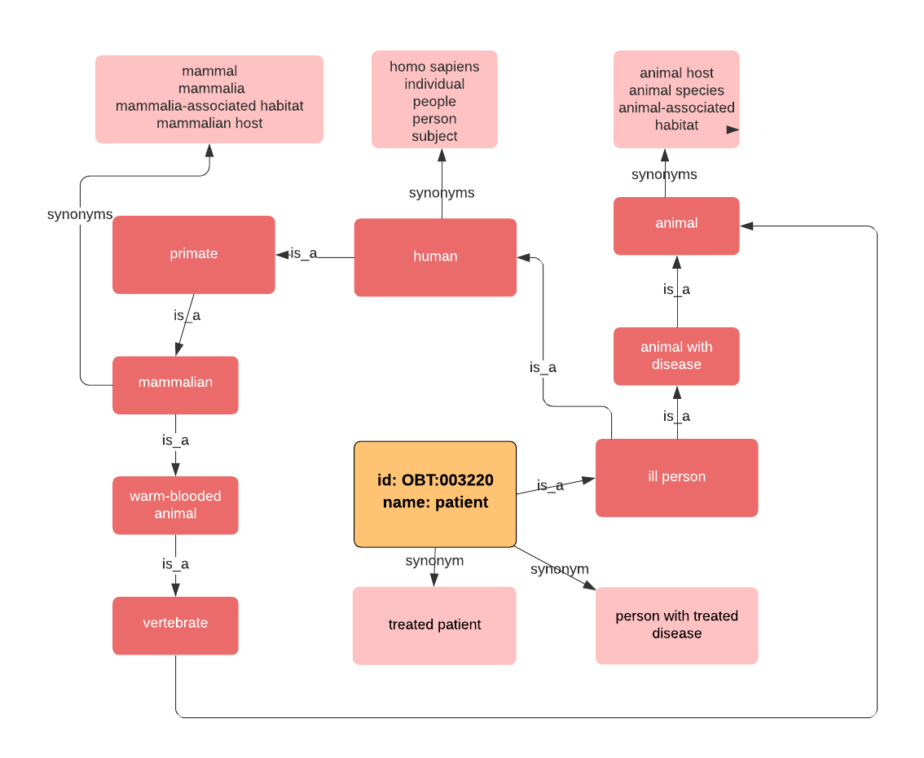
Future Work
[1] Graph based representation
of Ontology set
Using is_a / synonym relations
given in OntoBiotope dataset

Slide 11
Future Work
BioNLP word embeddings

Slide 12
Future Work
Part of Speech Tagger to extract valuable information
Noun phrases, noun clauses (NN)
e.g. TermName: sexually transmitted infection clinics. Found: patient with infectious disease. Actual: clinic
e.g. TermName: marine organisms. Found: marine environment. Actual: living organism
e.g. TermName: animal blood. Found: animal blood. Actual: blood

Slide 13
Future Work
Fasttext Based Word Embedding
Extention of word2vec modelling
Uses subword tokens as n-grams of characters
This helps capture the meaning of shorter words and allows the embeddings to understand suffixes and prefixes
e.g. TermName: gastroenteritis patients. Found: patient. Actual: patient with infectious disease
Gastroenteritis : known as infectious diarrhea
-itis : diseases characterized by inflammation

Slide 14
Thank you

